Slide 1
Professional Cleaning Salesperson Assignment

Slide 2
Business Problem
Developing an automatic way to assign tasks to salesperson based on the location of the prospective customers.

Slide 3
Data acquisition and cleaning
Fousquare API to dig into the prospective customers.
Information of localization from geocoder
Cleaning all inputs that is not from Ottawa
Fill all the location gaps with geocoder
Visualization with folium

Slide 4
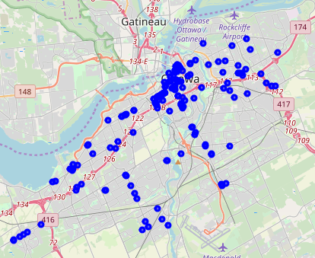
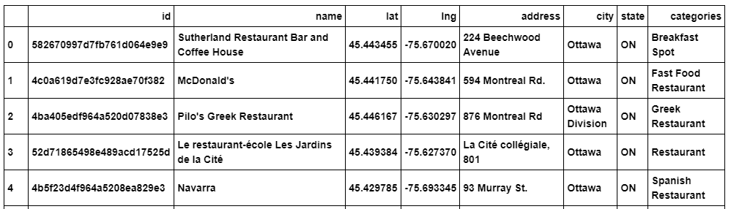
Dataset Sample
Location of prospective customers extracted from Foursquare API

Slide 5
Database on the Cloud
IBM-DB2 Stores the dataset

Slide 6
Clustering Models
Birtch - has reported the best results
K-Mean
DBSCAN

Slide 7
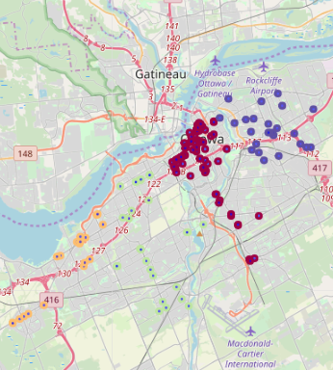
Venues Clustered
Four clusters were built by the algorithm, this is the results on the map.

Slide 8
Conclusion and future directions
Clustering was somewhat useful to perform the task
Improvement on algorithms to prevent overload
Road maps to increase the accuracy

